Slide 1


TypeScript Basics
BIT Project Programme

Slide 2


What is TypeScript ?
Basically TypeScript is a programming language to code JavaScript files more object oriented manner.
Compile
test.ts
( ES6 )
test.js
( ES5 )

Slide 3
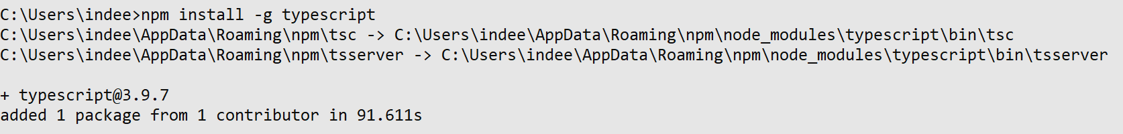
How to Install TypeScript Compiler
Install nodeJS and Connect to the internet
Open Command Prompt
Enter Below Command,
Finish the installation
npm install -g typescript
Note : We are installing typescript separately for testing purposes only. When we are installing angular typesript is automatically installed.
Don’t use shell based command line client (windows PowerShell), use windows command prompt
If any error occurred type “npm cache clean --force” command

Slide 4
First TypeScript File
Create a new folder as “TypeScript” in your desktop or as you like.
Create a file as “test.ts” in that folder.
Open it using a text editor like “Sublime Text”
Write Below code,
Open Command Prompt and navigate to the “ts” folder.
Enter Below Command,
Now you can see a file as “test.js” in the “ts” folder.
const message: string = 'hello world';
console.log(message);

Slide 5


First TypeScript File (Cont.)
test.ts
Compile
test.js

Slide 6


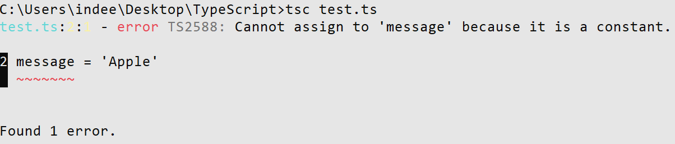

TypeScript Variable
TS
“const” keyword is used to define a constant in type script. It means that you can not change the value once declared.
TS
You can define a variable using “let” keyword.
TS

Slide 7
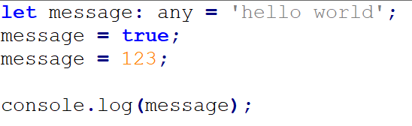
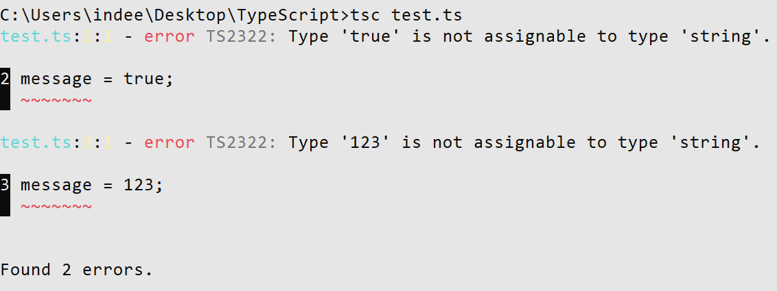
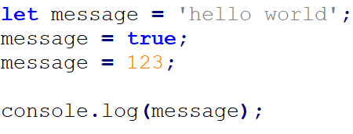
Data Types - Any
TS
“any” keyword is used for create variables with any data type.
Above code will be compiled successfully.
If one declared a variable without data type it will use the first value’s data type as variable’s datatype.
TS

Slide 8


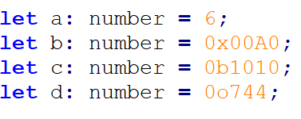
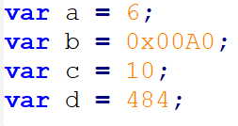
Data Types – Boolean, Number
Boolean
TS
JS
Number
TS
JS

Slide 9


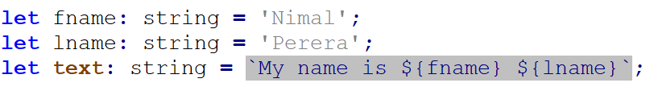

Data Types - String
TS
JS
Can use both single and double quotation sysmbols.
Template Strings
TS
JS

Slide 10


Array
TS
JS
Tuple
TS
JS
Tuple is used to create fix length arrays. In above example only two data can be stored in the array.

Slide 11
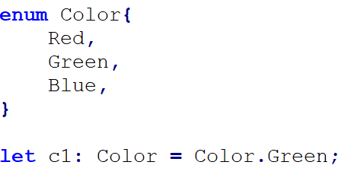
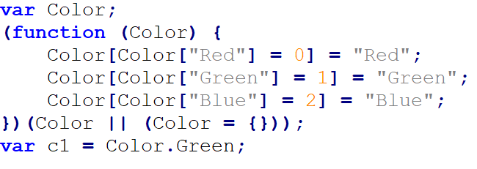
Data Types - Enum
TS
JS
“c1” variable has value is 1.

Slide 12
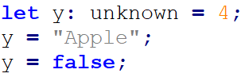

Data Types - Unknown
TS
JS
x : unknown = “Nimal”;
y : string = x;

Slide 13
Data Types - Object
Object is a type that represents the non-primitive type.
i.e. anything that is not number, string, boolean, or undefined.
TS
JS

Slide 14
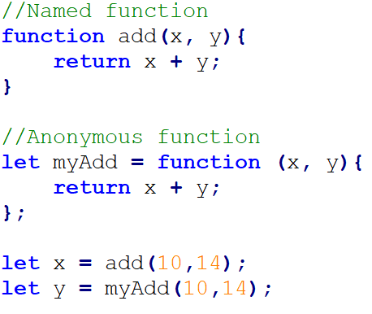
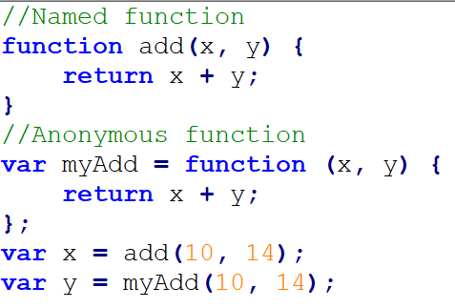
Functions
JS
TS

Slide 15
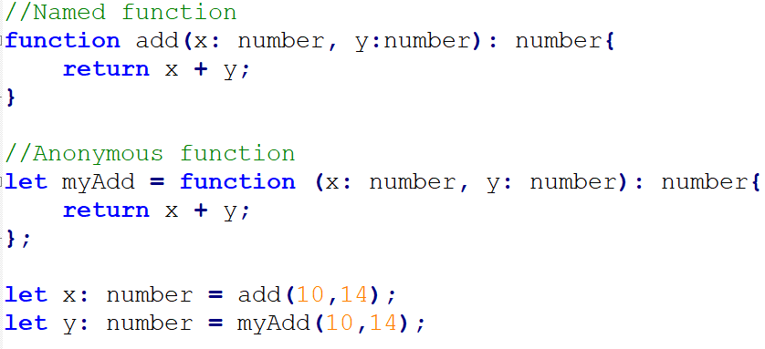
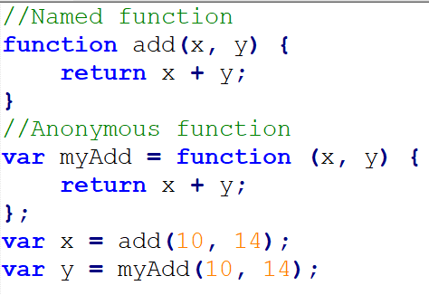
Functions with Return Type
Data types of parameters
Return type of the function
TS
JS

Slide 16
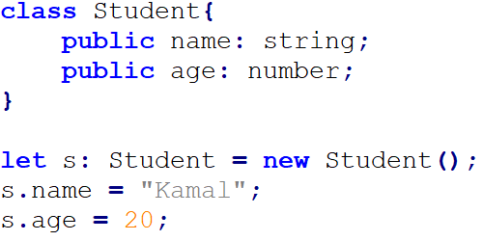
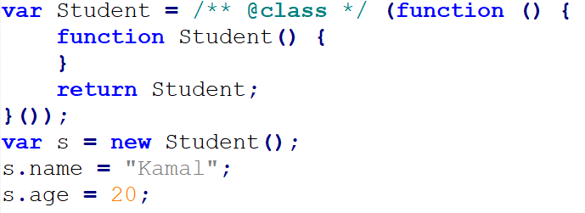
Classes and Objects
TS
JS
In js file dynamic object as created.

Slide 17
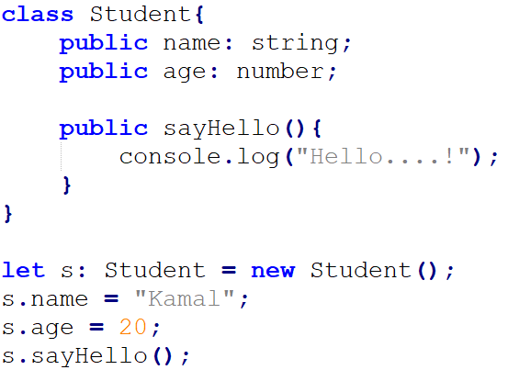
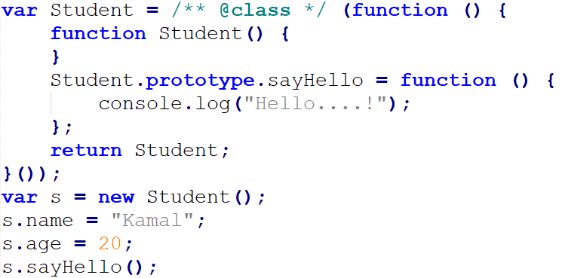
Classes and Objects (cont.) – Methods
JS
TS

Slide 18
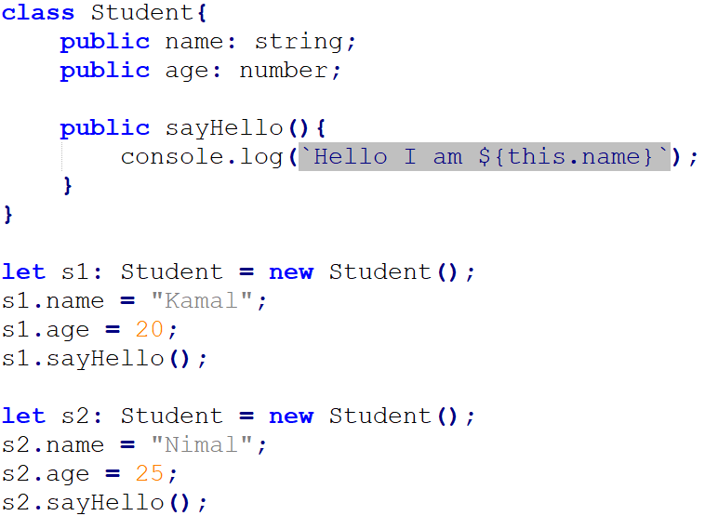
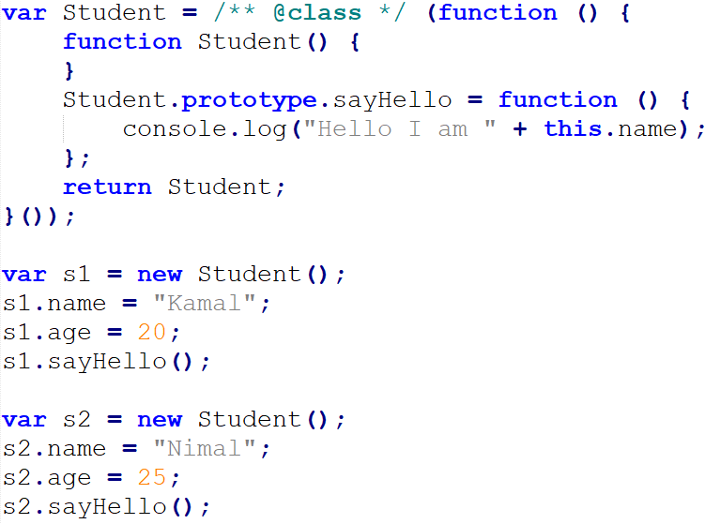
Classes and Objects (cont.) – “this” Keyword
Hello I am Kamal
Hello I am Nimal
TS
JS
“this” keyword refers to current object.

Slide 19
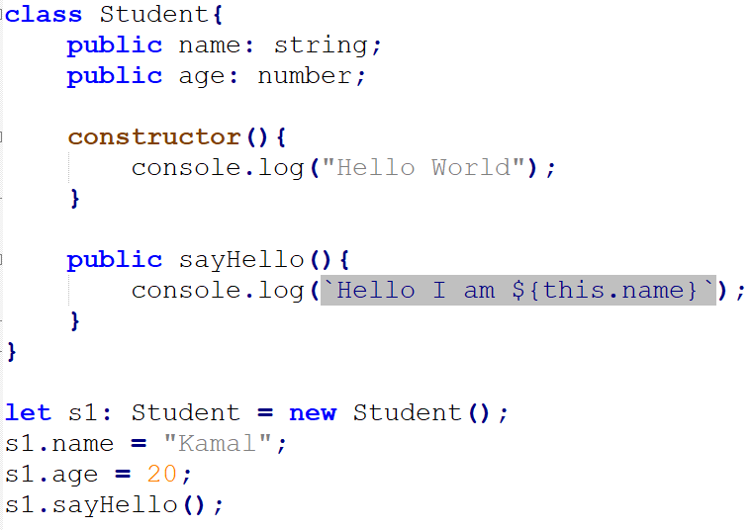
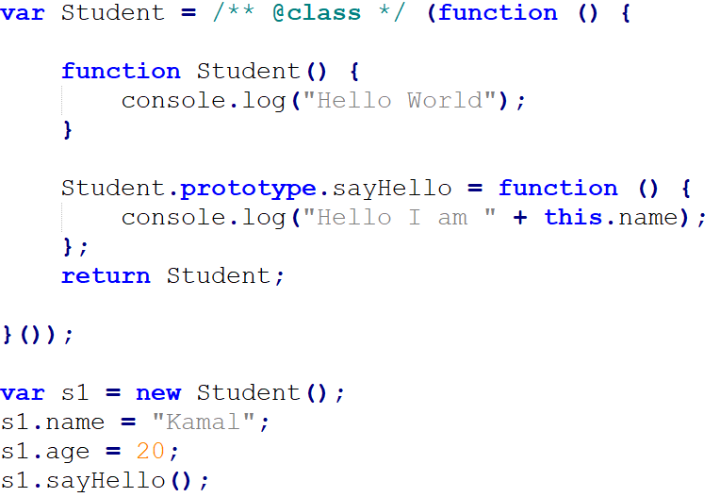
Classes and Objects (cont.) – Constructor
TS
JS

Slide 20
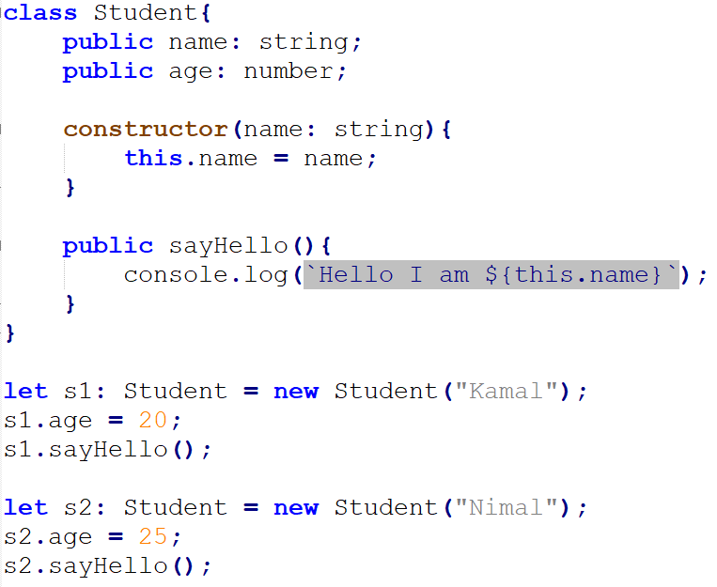
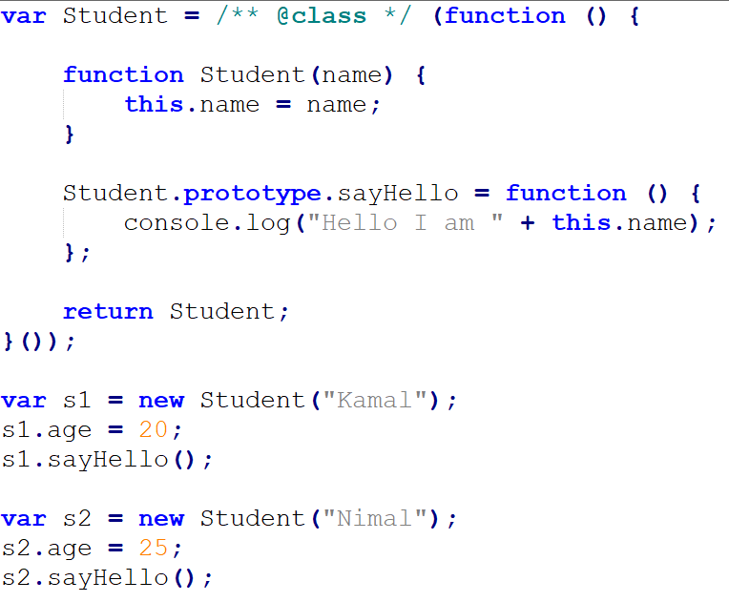
Classes and Objects (cont.) – Constructor with Parameters
TS
JS

Slide 21
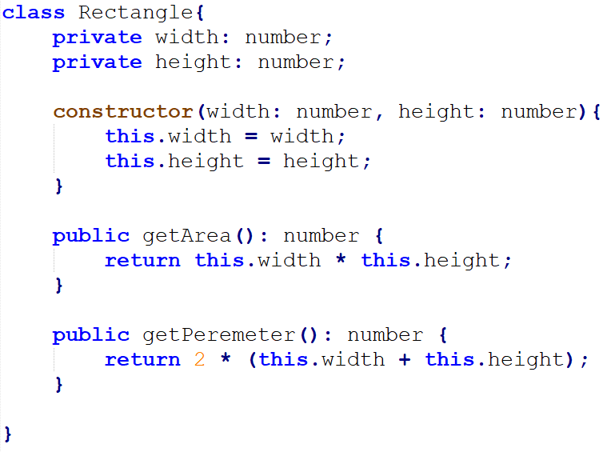
Activity 1
Create a class named “Rectangle”. The class has two private properties named “width” and “height”. Class has two operations getArea and getParameter. Width and height should be passed when creating an object.
TS

Slide 22
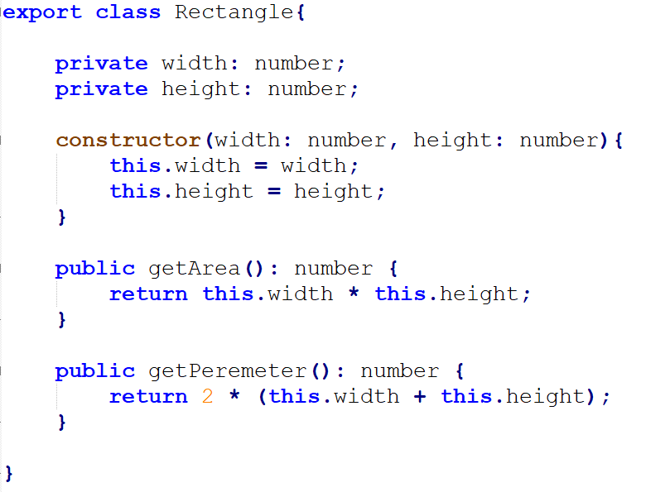
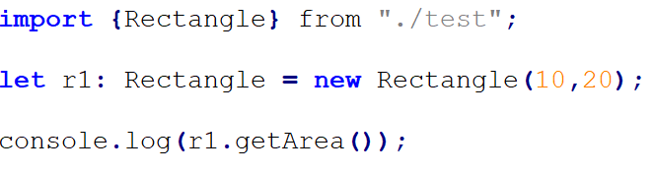
Modules
In order to use a class in another file, first we must export the class which needed to access from another file.
abc.ts
test.ts

